Slide 1

Tissue Annotation
Thierry Pécot
Research Associate
Translational Science Lab
Chan Zuckerberg Initiative Imaging Scientist

Slide 2
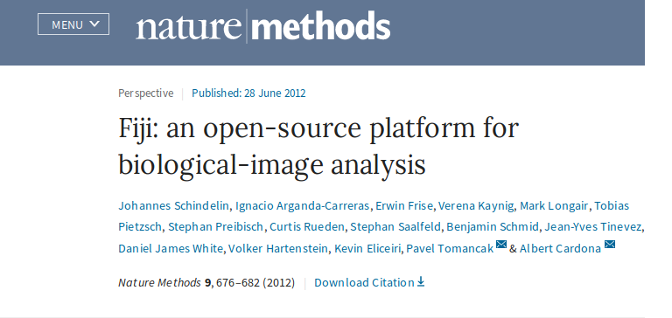
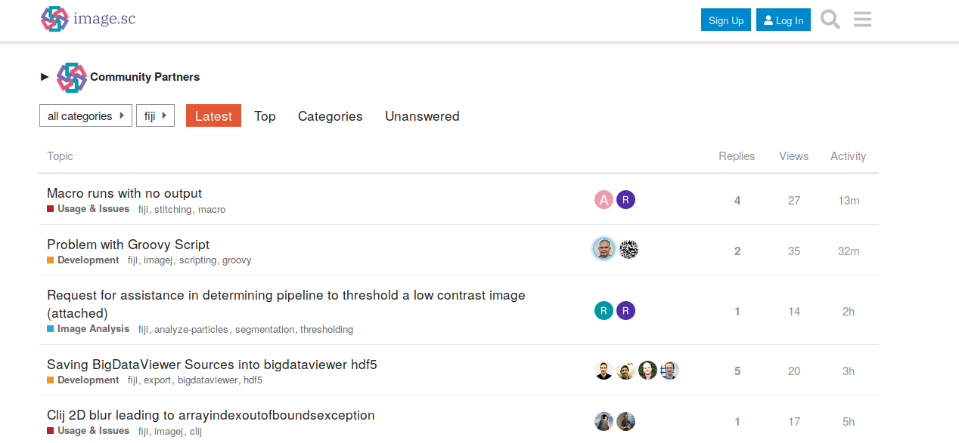
Annotater
Fiji
Fiji
Github page
Annotater
Video tutorials
Download Fiji and install Annotater Region annotation
Visualization tools Marker annotation
Object annotation Batch processing
Tutorial@I2K

